Slide 1
YOLO
This PPT is on working of YOLO. I made this PPT which is the compilation of screenshots and bookmarks from the videos on object detection and programming assignments. This PPT is mostly about what I understood from the Computer Vision course of Coursera, specially week 3 of the course.

Slide 2
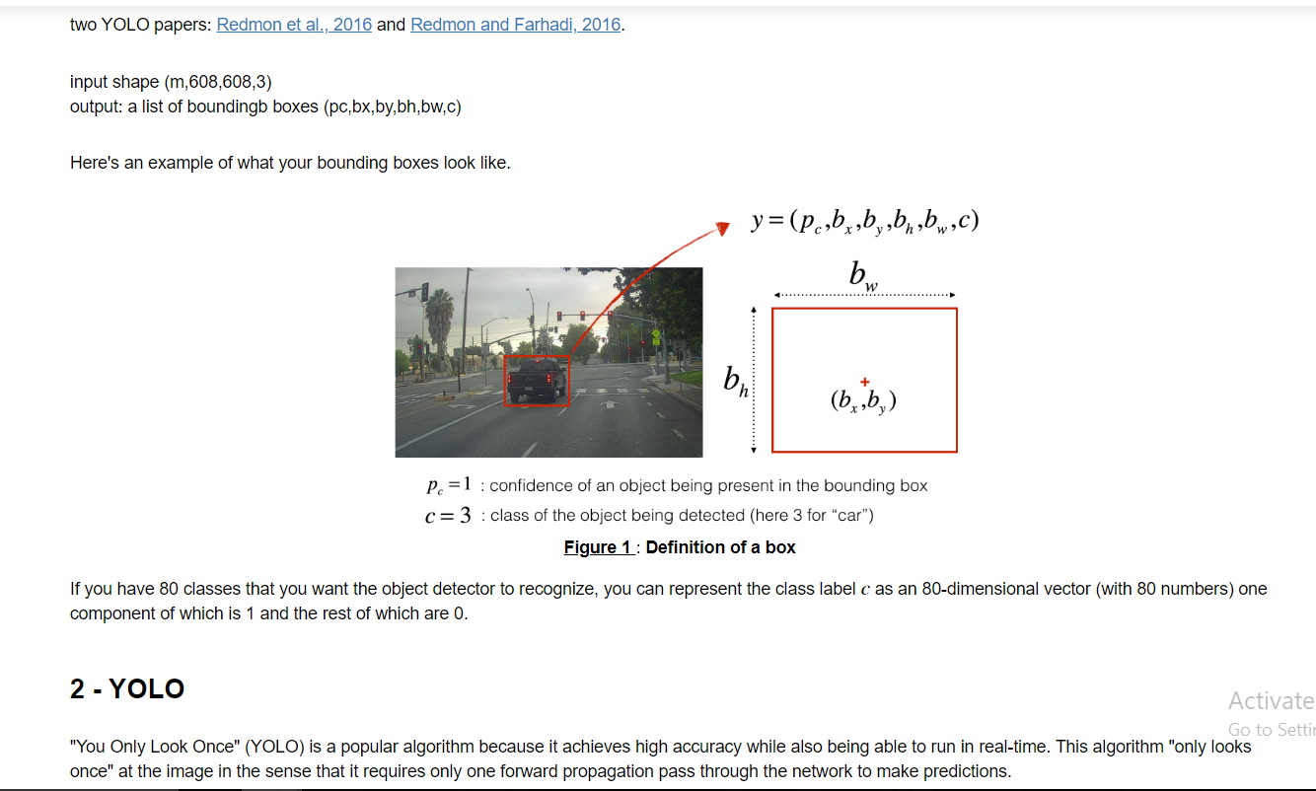

Slide 3
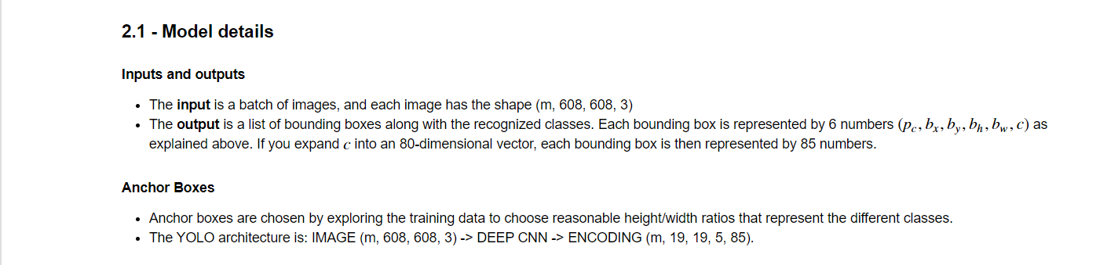
In the encoding shape(m,19,19,5,85) m are the number of examples(images) where each image is of size (19*19), 5 is the number of anchor boxes(we can choose any number according to our need) and 85 is the size of vector representing each bounding box([pc,bx,by,bh,bw,c1,c2……c80])

Slide 4
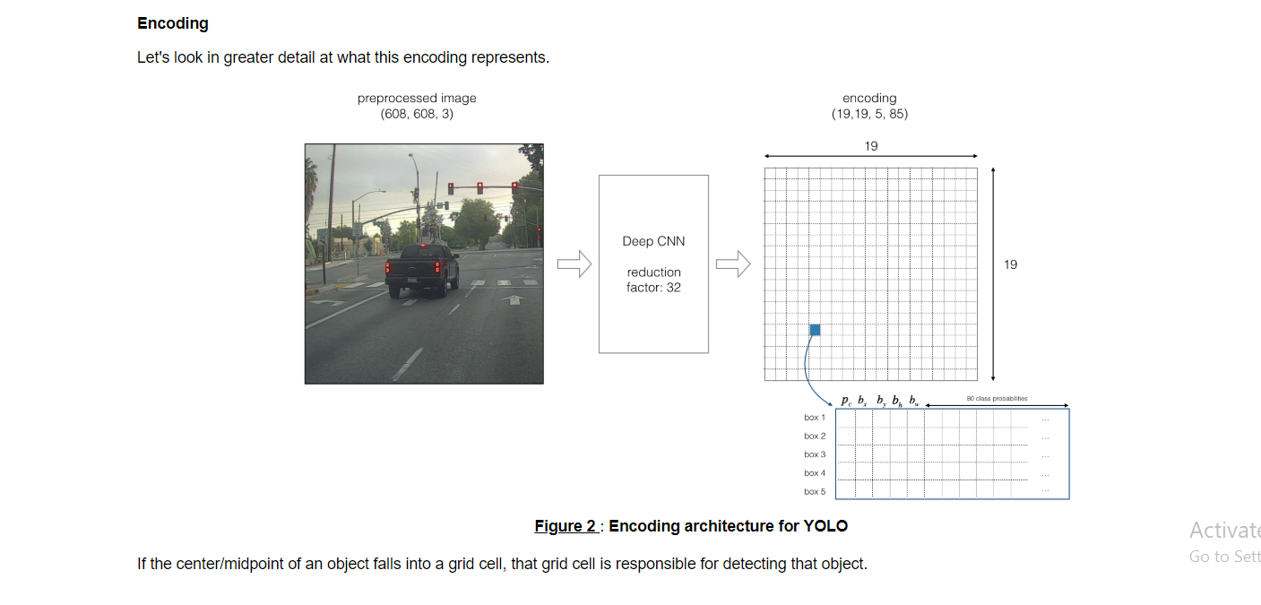

Slide 5
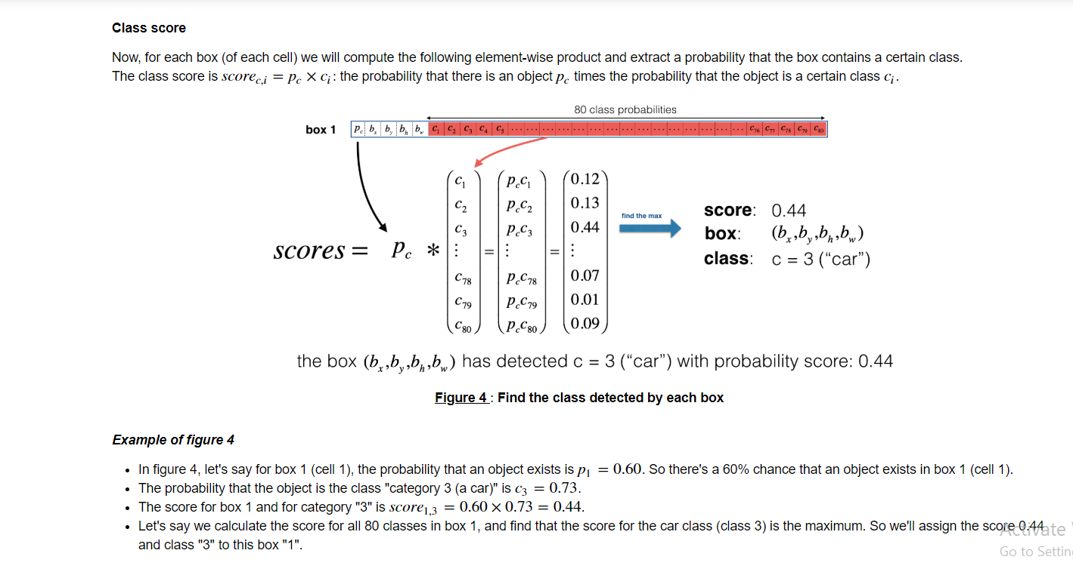

Slide 6
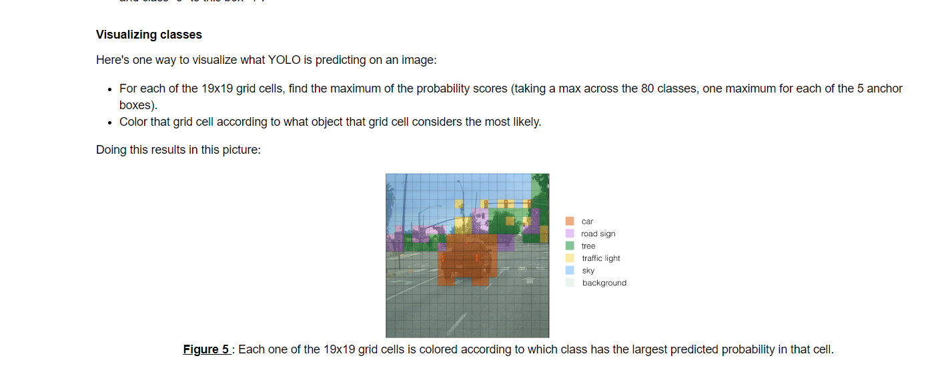
The image below is not final output of YOLO. IT just an intermediate result of the process done till now.

Slide 7
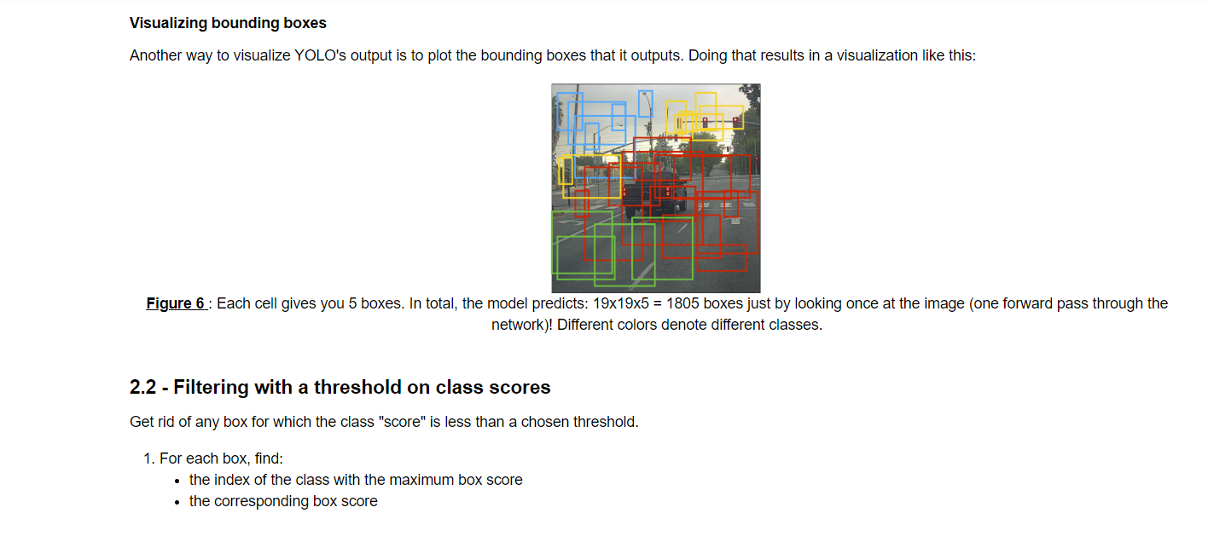
The image below is not final output of YOLO. IT just an intermediate result of the process done till now.

Slide 8
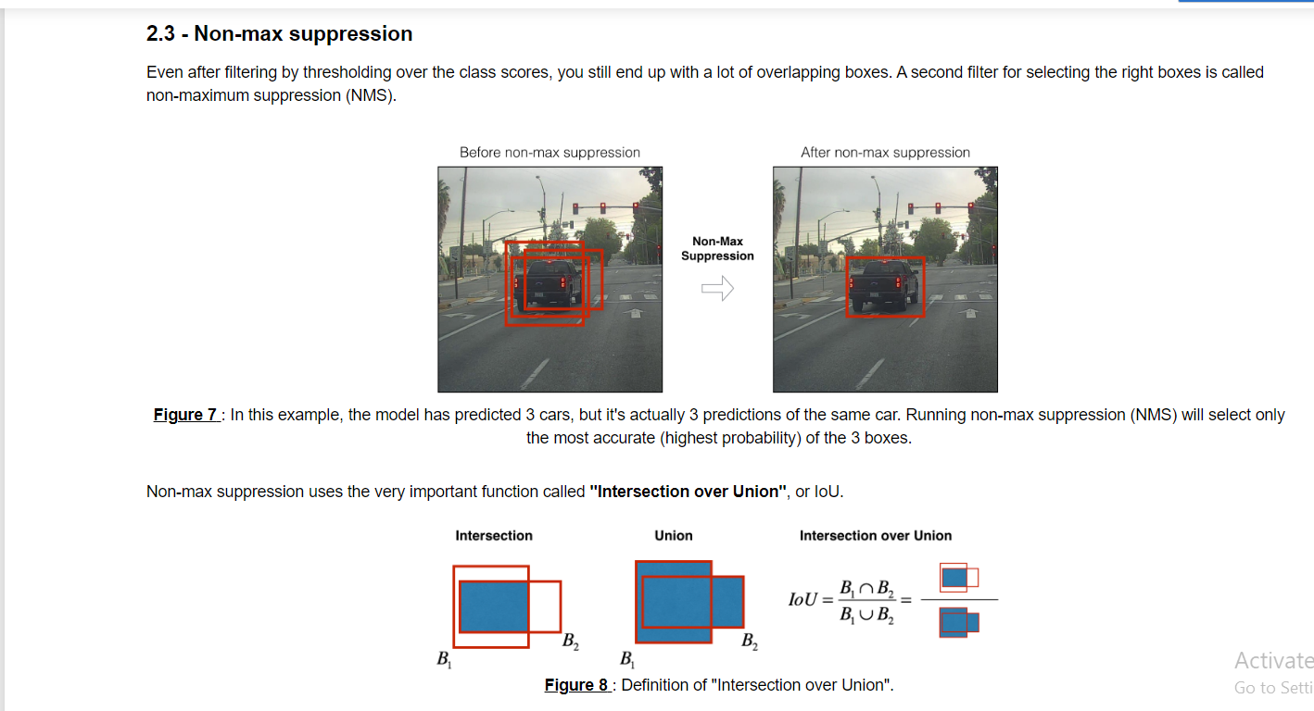

Slide 9
